Slide 1
NJIT University
ASP.NET Web Application

Slide 2
Built Using
Visual Studio 2013
Microsoft SQL Server
Entity Framework 6.1.3
Handles- Delete , Update and Insert operation concurrencies

Slide 3
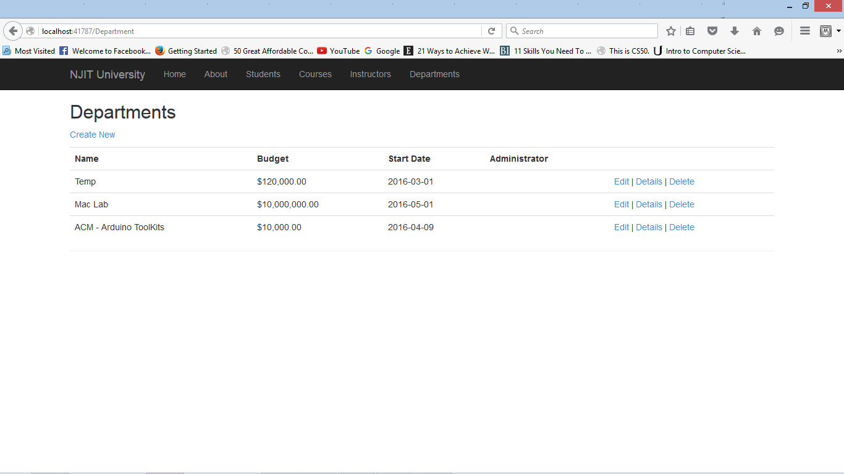
Initial Entries in Depatment

Slide 4
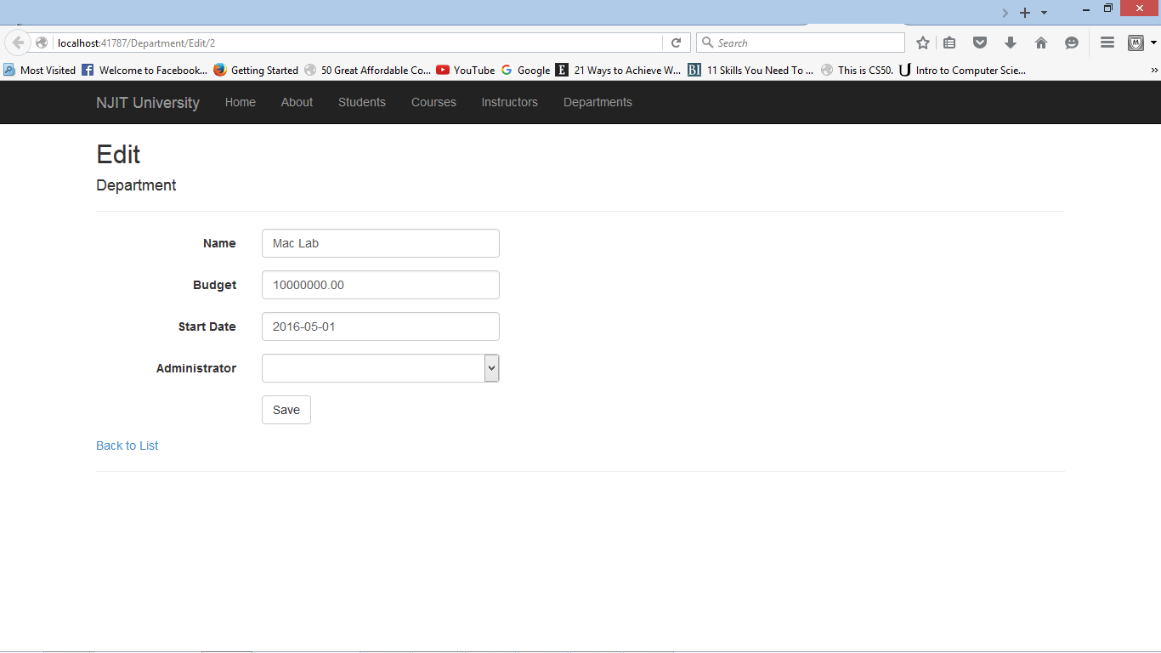
Edit Mac Lab value: Two edit tabs opened

Slide 5
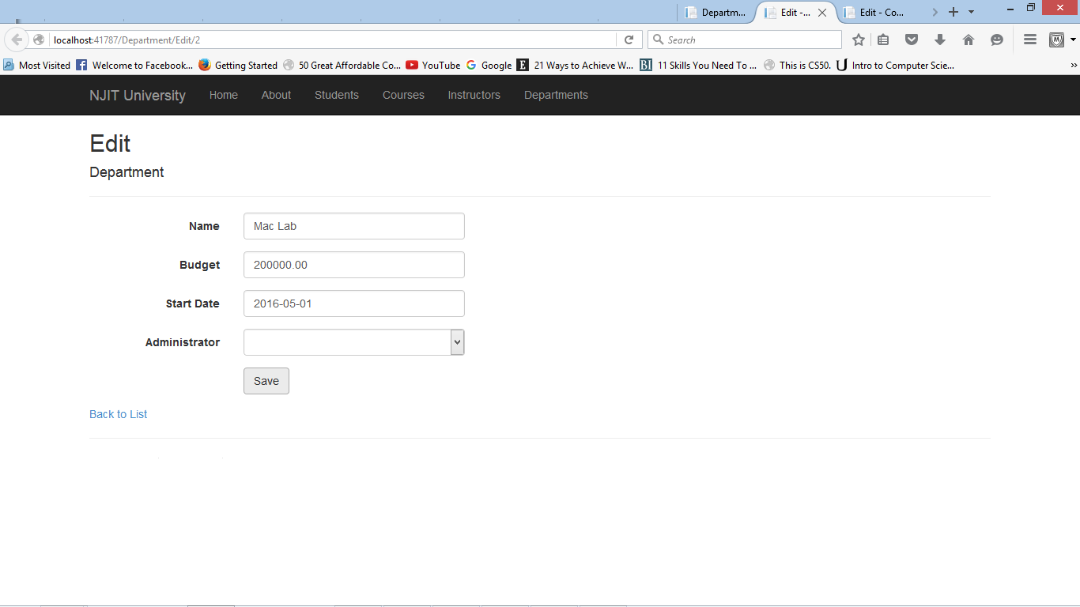
Budget value changed from 10000000 to 2000000

Slide 6
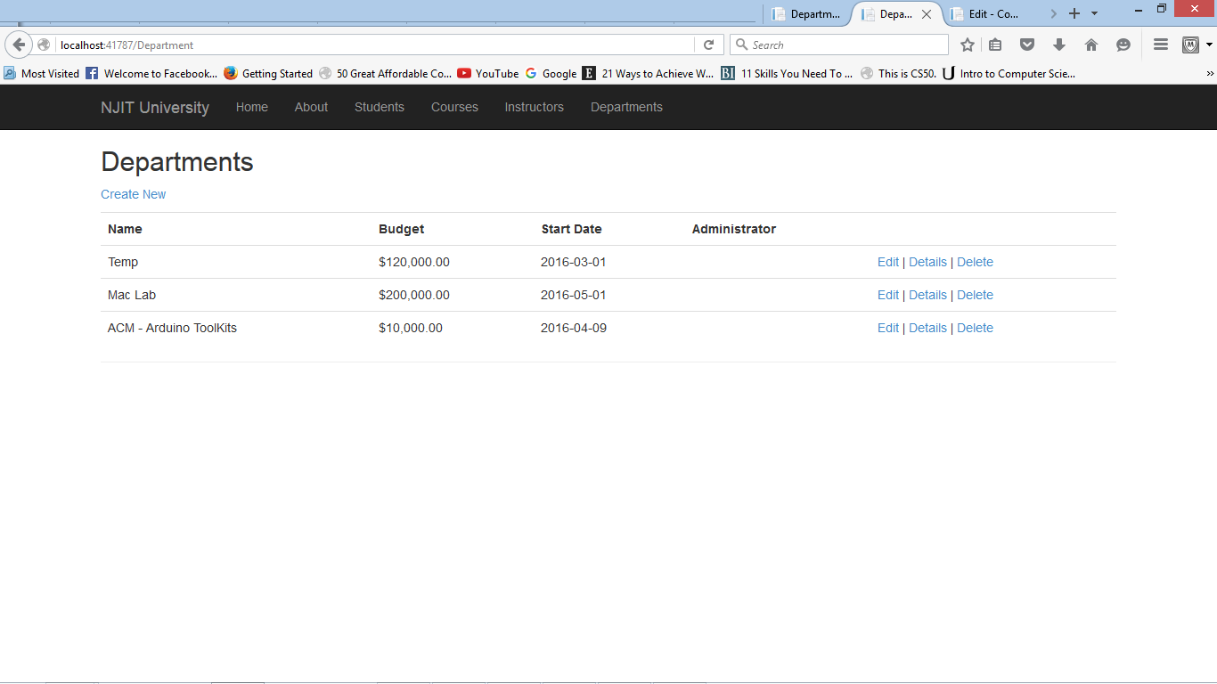
Departments tab after update

Slide 7
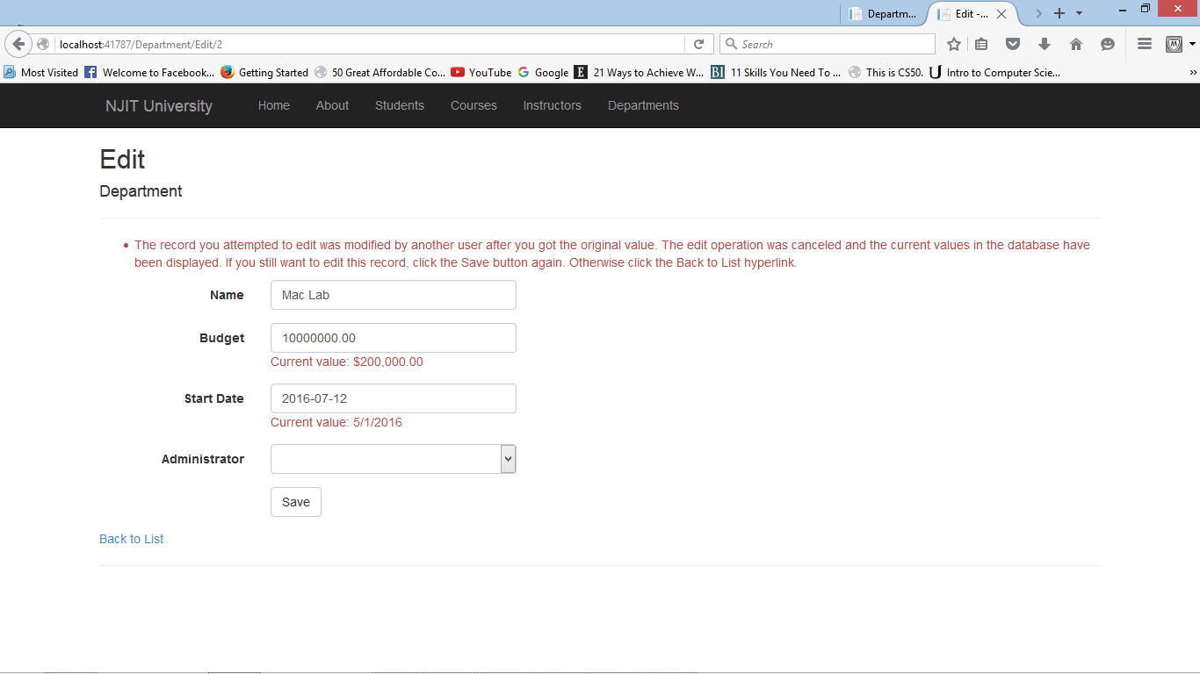
Error message displayed after second tab value user tries to save the modified Start Date

